Slide 1
Enforced Modularity by Client/Service
NFS

Slide 2
Case: NFS
NFS (Network File System)
  Sun, 1980s, workstations
  Centralized management: easy to share & backup
  Cost benefit: workstations without disks
NFS goals
  Compatibility with existing applications
  Easy to deploy
  OS independent: clients in DOS
  Efficient enough to be tolerable

Slide 3
Extend the UNIX FS to support NFS
Vnode
  Abstract whether a file or dir is local or remote
  In volatile memory
  Support several different local file system
Vnode API
  OPEN, READ, WRITE, CLOSE…
  Code of fd_table, current dir, name lookup, can be moved up to the file system call layer

Slide 4
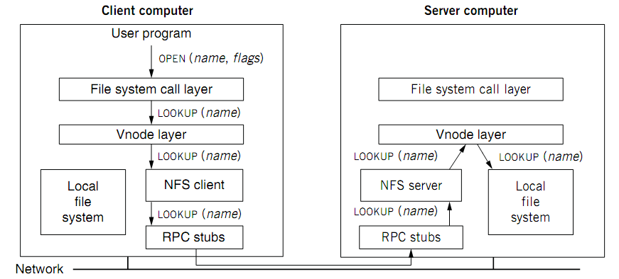
Extend the UNIX FS to support NFS

Slide 5
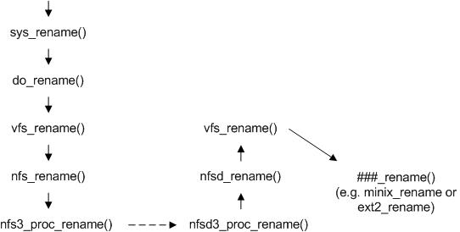
Rename of NFS

Slide 6
NFS Transport protocol
Originally used UDP.
  Better performance in LANs.
  NFS and RPC do their own reliability checks.
Most current implementations support also TCP.
  WANs: congestion control.
TCP officially integrated in NFS v.3.

Slide 7
Naming remote files and directories
Transparent to programs
  User cannot tell whether NFS or not
Mount
  # mount –t nfs 10.131.250.6:/nfs/dir /mnt/nfs/dir
File handle
  File system identifier: for server to identify the FS
  Inode number: for server to locate the file
  Generation number: for server to maintain consistency
  Usable across server failures, e.g. reboot
  Why not put path name in the handle?

Slide 8
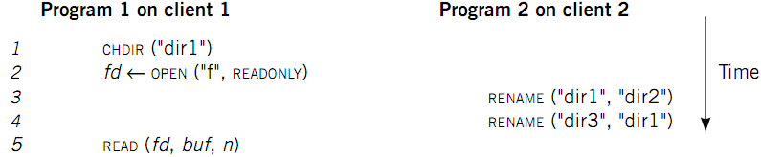
Corner case 1: rename after open
UNIX Spec:
  Program 1 should read “dir2/f”
  NFS should keep the spec

Slide 9
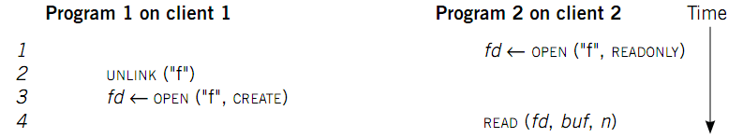
Corner case 2: delete after open
UNIX spec:
  On local FS, program 2 will read the old file
How to avoid program 2 reading new file?
  Generation number
  “stale file handler”
Not the same as UNIX spec! It’s a tradeoff.

Slide 10
Server side (II)
File handle consists of
  Filesystem id identifying disk partition
  I-node number identifying file within partition
  Generation number changed every time
  i-node is reused to store a new file
Server will store
  Filesystem id in filesystem superblock
  I-node generation number in i-node

Slide 11
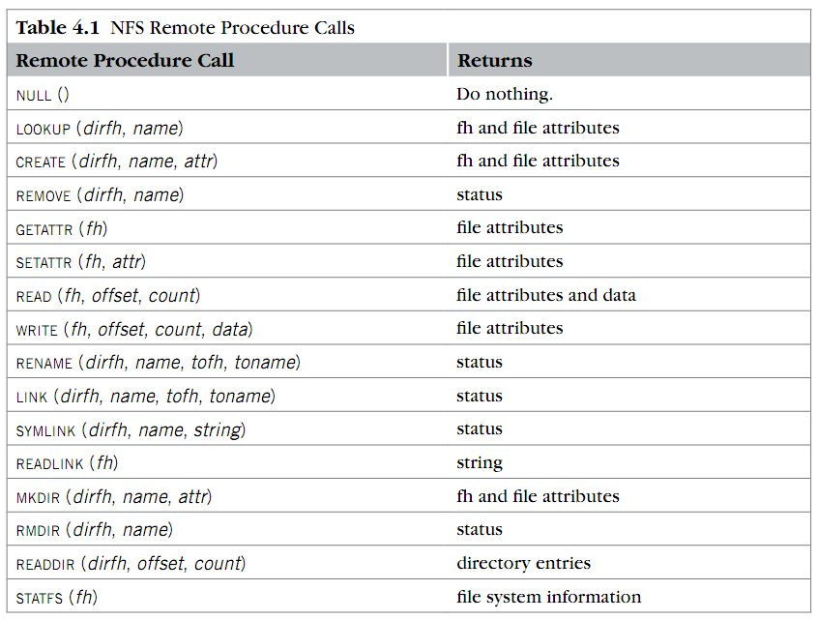
RPC in NFS
OPEN?
CLOSE?

Slide 12
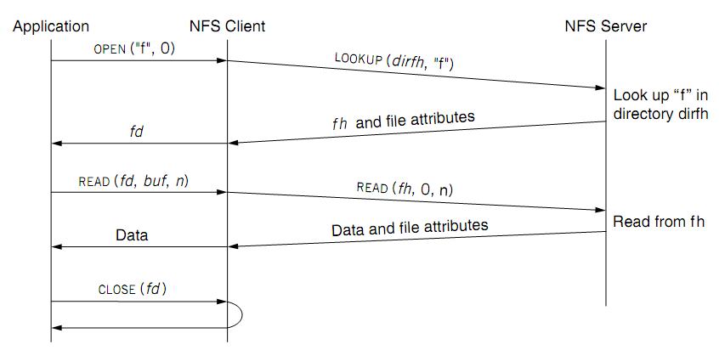
RPC in NFS
Stateless

Slide 13
The lookup call (I)
Returns a file handle instead of a file descriptor
  File handle specifies unique location of file
lookup(dirfh, name) returns (fh, attr)
  Returns file handle fh and attributes of named file in directory dirfh
  Fails if client has no right to access directory dirfh

Slide 14
The lookup call (II)
  One single open call such as
    fd = open(“/usr/joe/6360/list.txt”)
  will be result in several calls to lookup
  lookup(rootfh, “usr”) returns (fh0, attr)
  lookup(fh0, “joe”) returns (fh1, attr)
  lookup(fh1, “6360”) returns (fh2, attr)
  lookup(fh2, “list.txt”) returns (fh, attr)

Slide 15
The lookup call (III)
Why all these steps?
  Any of components of /usr/joe/6360/list.txt
  could be a mount point
  Mount points are client dependent and mount information is kept above the lookup() level

Slide 16
Stateless on NFS server
Stateless on NFS server
  Each RPC contains all the information
  Client maintains the state, e.g. the file cursor
  Client can repeat a request it receives a reply
    Server may execute the same requntiluest twice
    Solution: each RPC is tagged with a transaction number, server maintains some “soft” state: reply cache
    What if the server fails between two same requests?

Slide 17
Advantages of statelessness
Crash recovery is very easy:
  When a server crashes, client just resends request until it gets an answer from the rebooted server
  Client cannot tell difference between a server that has crashed and recovered and a slow server
Client can always repeat any request

Slide 18
Consequences of statelessness
Read and writes must specify their start offset
  Server does not keep track of current position in the file
  User still use conventional UNIX reads and writes
“open” system call translates into several
lookup calls to server
No NFS equivalent to UNIX close system call

Slide 19
Cache on client
NFS client maintains various caches
  Stores vnode for every open file
    Know the file handles
  Recently used vnodes, attributes, recently used blocks, mapping from path name to vnode
Cache benefits
  Reduce latency
  Less RPC, reduce load on server

Slide 20
Example
A
B
Server
x’
x’’
x
Inconsistent updates

Slide 21
Example
Consider a one-block file X that is concurrently modified by two workstations
If file is cached at both workstations
  A will not see changes made by B
  B will not see changes made by A
We will have
  Inconsistent updates
  Non respect of UNIX semantics

Slide 22
Coherence
Read/write coherence
  On local file system, READ gets newest data
  On NFS, client has cache
  NFS could guarantee read/write coherence for every operation, or just for certain operation
Close-to-open consistency
  Higher data rate
  GETATTR when OPEN, to get last modification time
  Compare the time with its cache
  When CLOSE, send cached writes to the server
Notes:
Mixed blocks, old and new

Slide 23
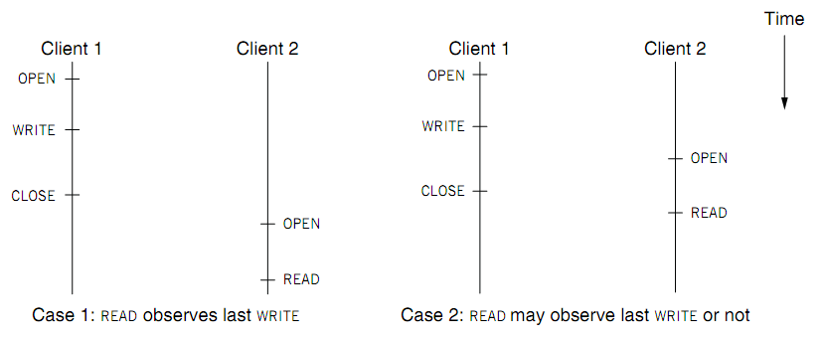
Coherence

Slide 24
UNIX file access semantics (I)
Conventional timeshared UNIX semantics guarantee that
  All writes are executed in strict sequential fashion
  Their effect is immediately visible to all other processes accessing the file
Interleaving of writes coming from different processes is left to the kernel discretion

Slide 25
Server side (I)
Server implements a write-through policy（old version）
  Required by statelessness
  Any blocks modified by a write request (including i-nodes and indirect blocks)
  must be written back to disk before the call completes

Slide 26
UNIX file access semantics (II)
UNIX file access semantics result from the use of a single I/O buffer containing all cached blocks and i-nodes
Server caching is not a problem
Disabling client caching is not an option:
  Would be too slow
  Would overload the file server

Slide 27
Tuning (I)
First version of NFS was much slower than Sun Network Disk (ND)
1st improvement
  Added client buffer cache
  Increased the size of UDP packets from 2048 to 9000 bytes
2nd improvement ：reduced the amount of buffer to buffer copying in NFS and RPC (bcopy)

Slide 28
Tuning (II)
3rd improvement introduced a client-side attribute cache
  Cache is updated every time new attributes arrive from the server
  Cached attributes are discarded after
    3 seconds for file attributes
    30 seconds for directory attributes
These three improvements cut benchmark run time by 50%

